Slide 1


Promising or Elusive? Unsupervised Object Segmentation from Real-world Single Images
Yafei YANG , Bo YANG
vLAR Group, Department of Computing
The Hong Kong Polytechnic University
NeurlPS 2022

Slide 2
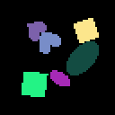
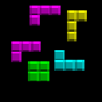
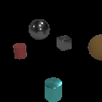
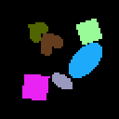


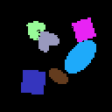
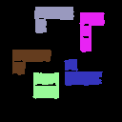

Unsupervised object segmentation from single images
Synthetic Images
Single Images
Ground Truth Segmentation Masks
Predicted Segmentation Masks
Experiment results from SlotAtt*
*Locatello, Francesco, et al. "Object-centric learning with slot attention." Advances in Neural Information Processing Systems 33 (2020): 11525-11538.

Slide 3
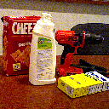
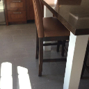
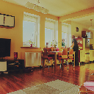

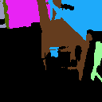
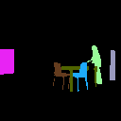
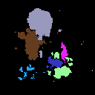
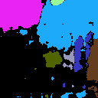

Unsupervised object segmentation from single images
Synthetic Images
Real-world Images
Single Images
Ground Truth Segmentation Masks
Predicted Segmentation Masks
Experiment results from SlotAtt*
*Locatello, Francesco, et al. "Object-centric learning with slot attention." Advances in Neural Information Processing Systems 33 (2020): 11525-11538.

Slide 4
Is it possible to segment generic
objects from real-world single images?

Slide 5
What to expect
Is it promising or even possible to segment generic objects from real-world single images using (existing) unsupervised methods?
4 complexity factors
6 benchmark datasets
4+1 representative approaches
15 types of ablation settings
210 experiments

Slide 6
Object Color Gradient
Object Shape Concavity
Inter-object Color Similarity
Inter-object Shape Variation
Complexity Factors
Notes:
Although it is well accepted that different datasets have different characteristic, few work has explicitly measure them.

Slide 7

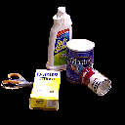
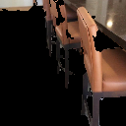


What is an object?
Synthetic Images
Real-world Images
How to quantify the objectness biases in datasets?
Complexity Factors
 | appearance | geometry
object-level | Object Color Gradient | Object Shape Concavity
scene-level | Inter-object Color Gradient | Inter-object Shape Variation

Slide 8
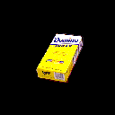
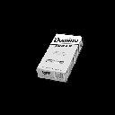
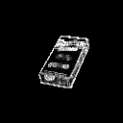

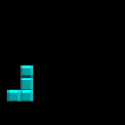


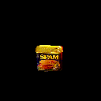
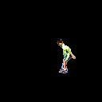
Complexity Factor - Object Color Gradient
object-level; appearance
Illustration
Example images and factor values
object image
grayscale image
0.000
0.165
gradient
0.518
0.802
object boundary
inner gradient

Slide 9
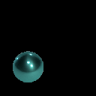



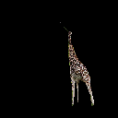

Complexity Factor - Object Shape Concavity
object-level; geometry
Illustration
Example images and factor values
0.020
0.121
object mask
smallest convex polygon mask
0.526
0.750

Slide 10
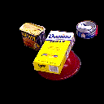

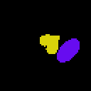
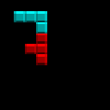
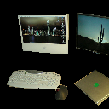
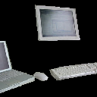
Complexity Factor – Inter-object Color Similarity
scene-level; appearance
Illustration
Example images and factor values
0.265
0.359
original
average color
average colors in RGB space
0.787
0.936

Slide 11
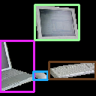
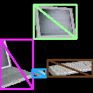
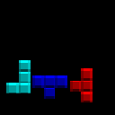

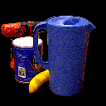
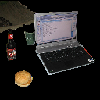

Complexity Factor – Inter-object Shape Variation
scene-level; geometry
Illustration
Example images and factor values
0.005
0.105
bounding boxes
diagonals
diagonal variation
0.257
0.565

Slide 12
dSprites
Tetris
CLEVR
YCB
ScanNet
COCO
6 Benchmark Datasets

Slide 13

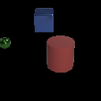
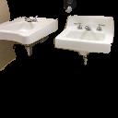
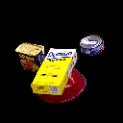
Biases in 6 Datasets - quantitative summary
Object Color Gradient
Object shape Concavity
dSprites
Tetris
CLEVR
Inter-object Color Similarity
Inter-object Shape Variation
YCB
ScanNet
COCO

Slide 14
AIR
MONet
IODINE
Slot Attention
Mask-RCNN*
4+1 Representative Methods

Slide 15
5 Methods on 6 Datasets
Quantitative Evaluation
dSprites
CLEVR
YCB
dSprites
YCB
COCO
dSprites
YCB
dSprites
YCB
dSprites
YCB
Tetris
ScanNet
COCO
Tetris
CLEVR
ScanNet
Tetris
CLEVR
ScanNet
COCO
Tetris
CLEVR
ScanNet
COCO
Tetris
CLEVR
ScanNet
COCO
(a) AIR
(b) MONet
(c) IODINE
(d) SlotAtt
(d) MaskRCNN
Unsupervised
Supervised

Slide 16
C: single color
S: convex shape
T: texture replaced
U: uniform scale
combinations of above four…
15 ablation settings
Notes:
In order to link above performance gap with dataset biases and also to investigate the biases of different models, we design a series of ablation experiments.

Slide 17
From complexity factors to ablation settings
Complexity Factor
 | appearance | geometry
object-level | Object Color Gradient | Object Shape Concavity
scene-level | Inter-object Color Gradient | Inter-object Shape Variation
Ablation Setting
 | appearance | geometry
object-level | C: single Color | S: convex Shape
scene-level | T: Texture replaced | U: Uniform scale
Notes:
In accordance with above complexity factors, we put forward four independent ablation settings.

Slide 18
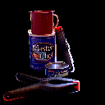
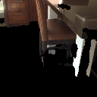
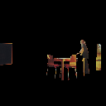


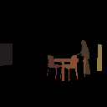
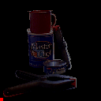
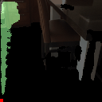
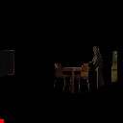


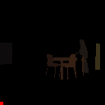
C - single Color ablation
Average color in each object
YCB
ScanNet
COCO
YCB-C
ScanNet-C
COCO-C

Slide 19
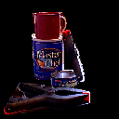
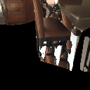
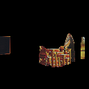
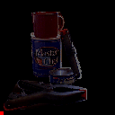
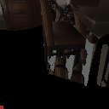
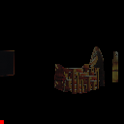
S - convex Shape ablation
Change shape each object to be convex
YCB
ScanNet
COCO
YCB-S
ScanNet-S
COCO-S

Slide 20






T – Texture replaced ablation
Change objects appearance with distinctive texture
YCB
ScanNet
COCO
YCB-T
ScanNet-T
COCO-T

Slide 21






U – Uniformed scale ablation
Change objects scale to be uniform
YCB
ScanNet
COCO
YCB-U
ScanNet-U
COCO-U

Slide 22






CSTU – fully ablated
Apply all four ablation above
YCB
ScanNet
COCO
YCB-CSTU
ScanNet-CSTU
COCO-CSTU

Slide 23
Quantitative results of ablation experiments
YCB and its 9 ablations
ScanNet and its 9 ablations
COCO and its 9 ablations

Slide 24





Why do unsupervised models fail on real-world datasets?
 | object-level |  | scene-level
 | Object Color Gradient | Object Shape Concavity | Inter-object Color Similarity | Inter-object Shape Variation
AIR
MONet
IODINE
Slot Attention
Finding 1
Different models favor different objectness bias;
Finding 2
None of the model can fully capture the true objectness biases in real-world images.

Slide 25



Can unsupervised methods segment objects from single images?
Success on synthetic datasets vs. Failure on real-world datasets
6 dataset
4 + 1 methods
unsupervised segmentation methods
synthetic datasets
real-world datasets
15 ablation settings
effectiveness of complexity factors;
objectness biases in different models.
4 complexity factors
Quantitatively evaluate the objectness biases in datasets
Future direction
more discriminative objectness biases (e.g. motions);
learn from single-object-dominant dataset.
Notes:
In summary, we study the failure of unsupervised segmentation on real-world images by exploring objectness biases in datasets and model design.

Slide 26
Thanks
Project page: https://vlar-group.github.io/UnsupObjSeg.html
GitHub: https://github.com/vLAR-group/UnsupObjSeg
Arxiv: https://arxiv.org/abs/2210.02324
Notes:
That’s all for our presentation.
Thank you for your listening.
And welcome to visit our webpage and github project to know more details.

